Slide 1

Excel Beg to Adv

Slide 3
Introduction To Excel
Introduction
Interface
Tabs and Ribbons
Document Windows
Navigation Tips
File Menu and Save
Entering Data and Importing Data
Fonts and Alignment
Cut, Copy and Paste
Paste Special
Undo and Redo
Finding and Replacing a Value
Cell Styles
Formatting Numbers and Dates
Comments
Assignment

Slide 4
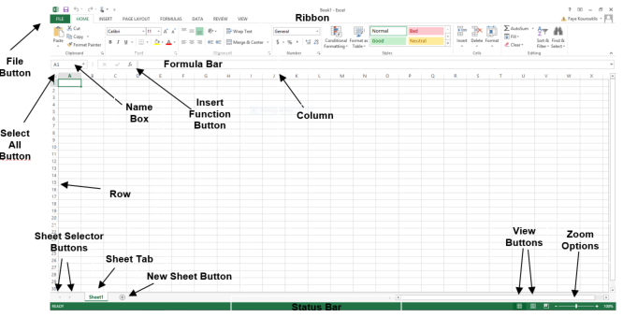
https://www.w3schools.com/excel/excel_introduction.php

Slide 5
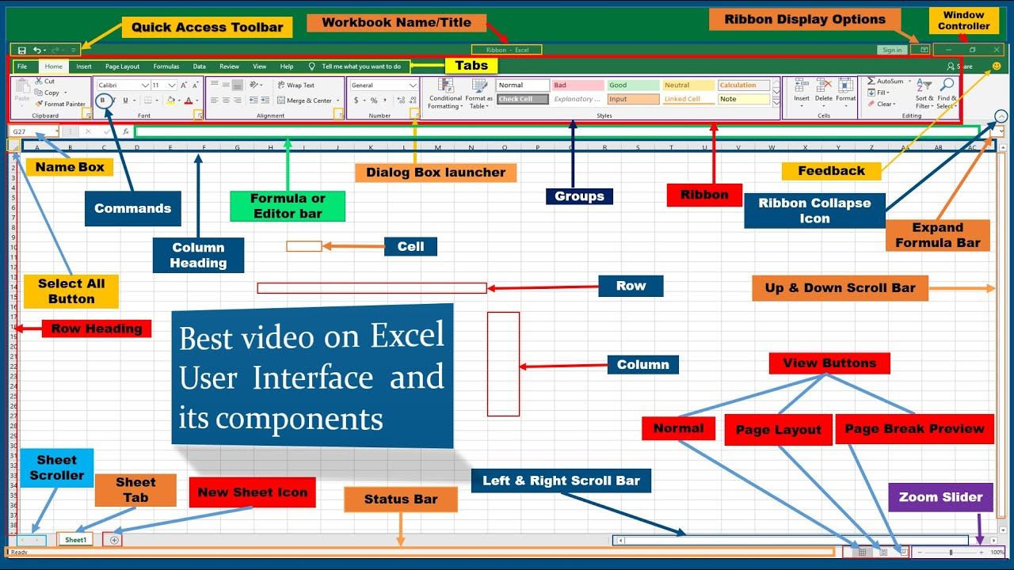

Slide 6
Formula and Function
Introduction to Formulas
Creating Formulas using Operators (=a1+b1) ,+,-,*,
AutoSum (sum ,min,max,count,count,avg)
Common Formulas
Formulas Tab
Copying Formulas
Date Functions (Today, date, datediff, edate,day,month, year,now, weeknum,)
Text Functions (char,concatenate,find, len, lower,upper, mid, left, right,proper, replace,substitute, text,trim)
Assignment
Logical- And,or ,not, if ,iferror,
Lookup- column,row, vlookup,hlookup,index,match,offset,Hstack , xlookup
Maths – abs, aggregate, round,celing ,floor, sumproduct
https://colab.research.google.com/drive/1dFIXOcgOBbZ1HYbBCY9RQWsxfi72FrPC#scrollTo=aP4mLf_RKtus
https://support.microsoft.com/en-us/office/excel-functions-by-category-5f91f4e9-7b42-46d2-9bd1-63f26a86c0eb

Slide 7
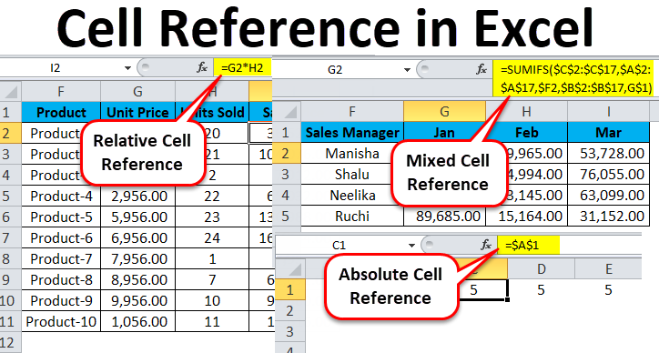
Formula Referencing
Relative References
Absolute References
Mixed References
Multiple Sheet References
Consolidating Data
Tracing the Precedents and Dependents
Using Watch Window and Formula Evaluation
Assignment
https://www.educba.com/cell-reference-in-excel/

Slide 8
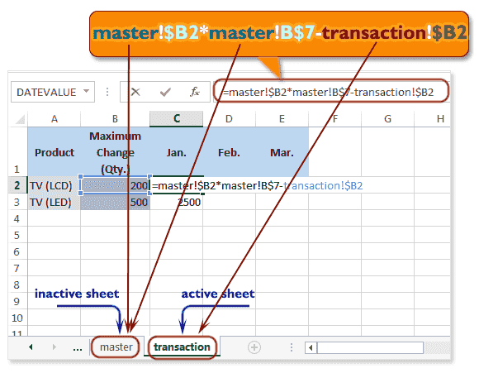
Multiple Sheet References
https://www.w3resource.com/excel/excel-cell-reference.php

Slide 9
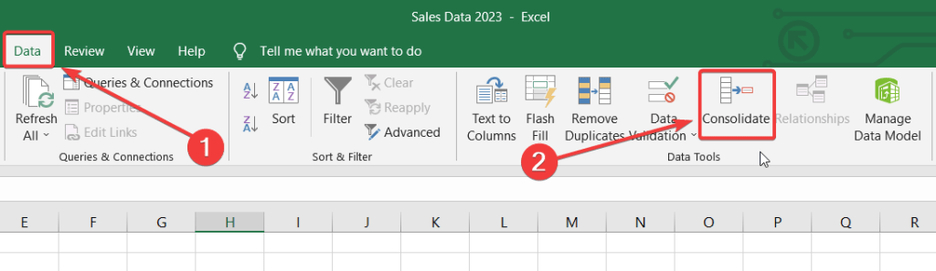
Consolidating Data
Tracing the Precedents and Dependents
Using Watch Window and Formula Evaluation
https://blog.coupler.io/consolidate-data-in-excel/
https://www.onlyoffice.com/blog/2023/11/trace-precedents-and-dependents-in-excel
https://www.customguide.com/excel/watch-window-excel

Slide 10
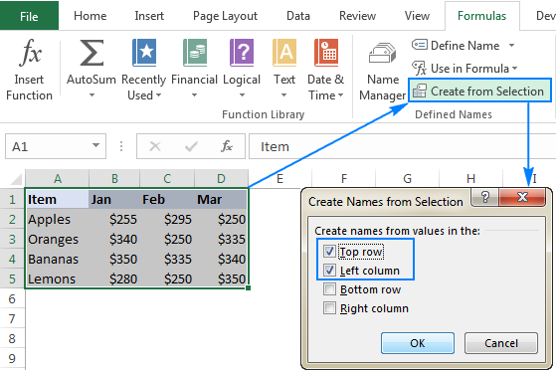
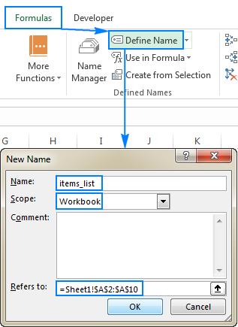
Named Ranges
Defined Names
Named Ranges
Formulas with named ranges
Assignment
https://www.ablebits.com/office-addins-blog/excel-named-range/

Slide 11
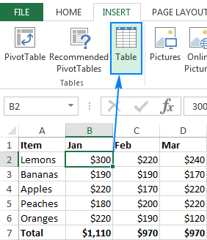
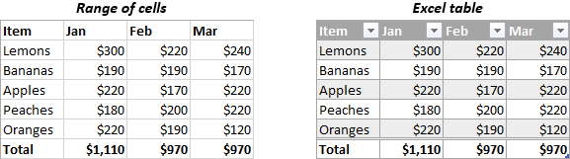
Table in Excel
Insert a Table and Style Options
Add Rows and Columns
Perform a Function in a Table
Assignment
https://www.ablebits.com/office-addins-blog/excel-table-tutorial/

Slide 12
AutoFill and Custom Lists
AutoFill a Series
AutoFill Non-Adjacent Cells
AutoFill on Multiple Sheets
Creating Custom Lists
Series Formatting
Sorting using Custom List
Assignment
AutoFill is used to fill a series of numbers, dates, or text automatically based on a pattern you define.
2. AutoFill Non-Adjacent Cells
AutoFill can be used for non-adjacent cells if you first select the non-contiguous range.
Steps:
Select the first cell, then hold Ctrl and click on the non-adjacent cells.
Use the AutoFill handle to drag and fill the series.
Example:
Fill every other cell with a number sequence (e.g., 1, 2, 3 in A1, A3, A5, etc.).
https://www.pryor.com/blog/create-a-custom-autofill-series-in-excel/

Slide 13
3. AutoFill on Multiple Sheets
You can fill a series across multiple sheets at once.
Steps:
Select multiple sheets by holding down Ctrl or Shift while clicking on the sheet tabs.
Enter the value in one sheet and use the AutoFill handle.
Excel will fill the same series across all selected sheets.
Example:
If you want to fill the same date range across Sheet1, Sheet2, and Sheet3, select all three sheets and then fill the dates.
4. Creating Custom Lists
Custom Lists allow you to create predefined lists that you can use repeatedly for sorting or AutoFill purposes.
Steps:
Go to File > Options.
Select Advanced, then scroll down to the General section.
Click Edit Custom Lists....
Enter your list (e.g., Product A, Product B, Product C) and click Add.

Slide 14
5. Series Formatting
You can format your AutoFill series based on specific number or date patterns.
Steps:
Enter a starting value (e.g., January 1, 2024).
Click and drag the fill handle while holding the right mouse button.
When you release, select Fill Series or Fill Days, Fill Months, etc., to format it accordingly.
Example:
You can fill dates by month, by year, or skip weekends, depending on the series you choose.
6. Sorting using Custom Lists
You can sort data in a custom order using the lists you create.
Steps:
Select the range of data you want to sort.
Go to the Data tab and click Sort.
In the Order dropdown, choose Custom List....
Select your custom list from the options.

Slide 15
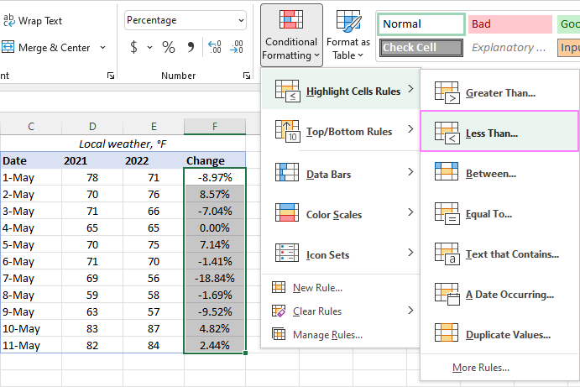
Conditional Formatting
Highlight Cells Rules
Top/Bottom Rules
Data Bars
Color Scales & Icons
Custom Formatting Rule
Assignment
Conditional Formatting allows you to format cells based on specific criteria, making it easy to visualize trends, identify high/low values, or highlight important data.
https://www.ablebits.com/office-addins-blog/excel-conditional-formatting/

Slide 16
4. Data Bars
Displays horizontal bars inside cells to visually represent the value relative to other cells.
Steps:
Select the range of numeric data.
Go to Conditional Formatting > Data Bars.
Choose a Gradient Fill or Solid Fill style.
Example:
Apply data bars to sales numbers to show performance. Higher values will have longer bars.
5. Color Scales & Icons
Color Scales: Shades cells with different colors based on their value relative to the others.
Icons: Adds symbols (e.g., arrows, traffic lights) based on predefined rules for high, medium, and low values.
Steps:
Select the range.
Go to Conditional Formatting > Color Scales or Icon Sets.
Choose a color scale or icon set.
Examples:
Color Scales: Apply a color scale to a column of numbers to shade low values in red and high values in green.
Icon Sets: Use traffic lights to represent performance levels (green for high, yellow for average, red for low).
6. Custom Formatting Rule
You can create custom formulas for conditional formatting to highlight data based on complex conditions.
Steps:
Select the range.
Go to Conditional Formatting > New Rule.
Select Use a formula to determine which cells to format.
Enter the formula and set the formatting.
Examples:
Custom Formula for Dates: Highlight overdue tasks (dates earlier than today).
Formula: =A1<TODAY()
Custom Formula for Multiple Conditions: Highlight cells where sales are greater than $5000 but less than $10,000.
Formula: =AND(A1>5000, A1<10000)
1. Conditional Formatting Overview
Conditional Formatting allows you to format cells based on specific criteria, making it easy to visualize trends, identify high/low values, or highlight important data.
2. Highlight Cells Rules
This feature highlights cells based on predefined rules like values, text, dates, or duplicates.
Steps:
Select the range of cells to apply the rule.
Go to the Home tab and click Conditional Formatting.
Choose Highlight Cells Rules from the dropdown.
Select the condition you want (e.g., Greater Than, Less Than, Text That Contains, etc.).
Define the value or text and set the formatting.
Examples:
Greater Than: Highlight all sales greater than $5000 with a green fill.
Formula: =A1>5000 (for numbers in range A1
).
Text That Contains: Highlight all cells containing the word "Refund".
Formula: =SEARCH("Refund", A1) (for cells in column A).
3. Top/Bottom Rules
Highlights the top or bottom values in a selected range.
Steps:
Select the range.
Go to Conditional Formatting > Top/Bottom Rules.
Choose options like Top 10 Items, Top 10%, Bottom 10%, or Above/Below Average.
Set the formatting style for the selected rule.
Examples:
Top 10 Items: Highlight the top 10 sales values in your dataset.
Bottom 10%: Highlight the bottom 10% of performance scores.

Slide 18
Assignment: Applying Conditional Formatting in a Dataset
You have been given a Sales Dataset for a store. Your task is to apply various conditional formatting techniques to visualize important information:
Highlight Cells Rules:
Highlight all sales greater than $10,000 with a green fill color in column B (Sales Amount).
Highlight all sales that are less than $2,000 in red.
Top/Bottom Rules:
Highlight the top 5 sales values in column B with blue fill.
Highlight the bottom 10% of sales in column B with orange fill.
Data Bars:
Apply Data Bars to the sales numbers in column B to visually represent the size of each sale.
Color Scales:
Use a Color Scale to shade the sales figures in column B, with lower numbers shaded in red and higher numbers shaded in green.
Icon Sets:
Apply Icon Sets (e.g., traffic lights) to the Sales Performance column (C). Use the following criteria:
Green light for values greater than 80.
Yellow light for values between 50 and 80.
Red light for values below 50.
Custom Formatting Rule:
Create a custom rule to highlight all sales that occurred in the last 7 days (use column D for sale date).
Formula: =TODAY()-D1<=7.
Extra: Custom Formula for Highlighting Rows:
If you want to highlight entire rows based on the value in a particular column:
Example: Highlight rows where the sales amount in column B is greater than $10,000.
Steps:
Select the entire table range.
Go to Conditional Formatting > New Rule.
Choose Use a formula and enter: =$B1>10000.
Apply a fill color to highlight the entire row.

Slide 19
Logical Functions
If statement
Nested If
AND,OR, NOT
IFERROR
SUMIF & COUNTIF
SUMIFS & COUNTIFS
Assignment

Slide 20
Reference Functions
VLOOKUP & HLOOKUP
LOOKUP ,INDEX , MATCH,INDIRECT,OFFSET
ROW & COLUMN
Array Formulas
Assignment

Slide 21
Data Validation
Define Data Validation Rules
Data Validation Options
Drop-Down Lists
Data Validation using Custom Formulas
Validate the Worksheet
Assignment

Slide 22
Pivot Table
Create PivotTables
Choosing Fields
Customizing PivotTables Reports
Filtering PivotTables
PivotCharts
Assignment

Slide 23
Data Visualization
Creating Graphs
Chart Types
Identifying Chart Components
Inserting a Chart in a Worksheet?
Customizing Graphs?
Using the Graph Templates
Sparklines
Trendlines and Forecast Sheet
Assignment \

Slide 24
What-if Analysis
Scenario Manager
Goal Seek
Data Table
Solver Too
Assignment

Slide 25
Macros & VBA
Enabling the Developer Tab
Recording a Task
Executing and Deleting a Recorded Task
Customizing the Automated Tasks
Assignment

Slide 26
Excel with AI
Enabling Chat GPT Ad In and exploring Formulas

Slide 27
Your best quote that reflects your approach… “It’s one small step for man, one giant leap for mankind.”
- Neil Armstrong

